Slide 1
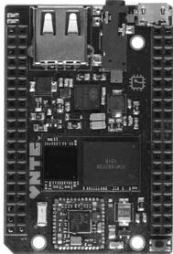
PinMap 08/2016 Humus, VGA, HDMI, Salsa, Relay, Tzatziki
Left Func | Left Used by | Left Func | Left Used by
GND | *all | CHR-IN | *All with DCDC
VCC5V | *VGA / HDMI | GND | *all
VCC33 | *VGA / HDMI | TS
VCC18 |  | VBAT
IC2-1 SDA | I2C-1 *SALSA | PWRON | *SALSA
I2C-1 SCL | I2C-1 *SALSA | GND | *all
X1 |  | X2
Y1 |  | Y2
D2 | *EEPROM | PWM0
D4 | VGA / HDMI | D3 | VGA / HDMI
D6 | VGA / HDMI | D5 | VGA / HDMI
D10 | VGA / HDMI | D7 | VGA / HDMI
D12 | VGA / HDMI | D11 | VGA / HDMI
D14 | VGA / HDMI | D13 | VGA / HDMI
D18 | VGA / HDMI | D15 | VGA / HDMI
D20 | VGA / HDMI | D19 | VGA / HDMI
D22 | VGA / HDMI | D21 | VGA / HDMI
CLK | HDMI | D23 | VGA / HDMI
VSYNC | VGA / HDMI | HSYNC | VGA / HDMI
GND | *all | DE | VGA / HDMI
Right Func | Right Used by | Right Func | Right Used by
GND | *all | VCC5 | *Power TZATZIKI
UART TX |  | HPL | Audio TZATZIKI
UART RX |  | HPCOM | Audio TZATZIKI
FEL |  | HPR | Audio TZATZIKI
VCC33 | *Power HUMUS | MICM
ADC |  | MICIN1
P0 | RELAY | P1
P2 | RELAY | P3
P4 | RELAY | P5 | *SALSA
 | TZATZIKI
P6 | RELAY | P7
GND | *all | GND | *all
EINT1 | HUMUS | EINT3 | Card det: TZATZIKI
I2C-2 SDA |  | I2C-2 SCL
SPI CS0 | HUMUS | SPI CLK | HUMUS
SPI MOSI | HUMUS | SPI MISO | HUMUS
CSID0 | DATA0: TZATZIKI | CSID1 | DATA1: TZATZIKI
CSID2 | DATA2: TZATZIKI | CSID3 | DATA3: TZATZIKI
CSID4 | CMD: TZATZIKI | CSID5 | CLK: TZATZIKI
CSID6 |  | CSID7
GND | *all | GND | *all
G
P
G
P
P
G
T
P
T
T
S
S
P
S
G
R
R
E
R
S
V
V
R
V
V
G
G
V
V
H
T
V
V
V
V
H
H
V
V
H
H
V
V
T
T
V
V
T
T
V
V
T
T
V
V
G
V
G
G

Slide 2
PinMap 11/2016 CHIP STATION PORTABLE v1
Left Func | Left Used by | Left Func | Left Used by
GND | *all | CHR-IN | *POWER IN
VCC5V | *Power Display | GND | *all
VCC33 | *GPIO Ext. + SD | TS
VCC18 |  | VBAT | *Battery
IC2-1 SDA | I2C-1 *GPIO Ext. | PWRON | *Power on
I2C-1 SCL | I2C-1 *GPIO Ext. | GND | *all
X1 |  | X2
Y1 |  | Y2
D2 | *EEPROM | PWM0 | Display
D4 | Display | D3 | Display
D6 | Display | D5 | Display
D10 | Display | D7 | Display
D12 | Display | D11 | Display
D14 | Display | D13 | Display
D18 | Display | D15 | Display
D20 | Display | D19 | Display
D22 | Display | D21 | Display
CLK | Display | D23 | Display
VSYNC | Display | HSYNC | Display
GND | *all | DE | Display
Right Func | Right Used by | Right Func | Right Used by
GND | *all | VCC5 | *Power Display
UART TX |  | HPL | Audio
UART RX |  | HPCOM | Audio
FEL |  | HPR | Audio
VCC33 | *Power Audio | MICM
ADC |  | MICIN1
P0 |  | P1
P2 | Home Btn | P3
P4 | Audio Shutd. | P5
P6 | Power led | P7 | Charge led
GND | *all | GND | *all
EINT1 | Keys interr. | EINT3 | Card det: SDCARD
I2C-2 SDA |  | I2C-2 SCL
SPI CS0 |  | SPI CLK
SPI MOSI |  | SPI MISO
CSID0 | DATA0: SDCARD | CSID1 | DATA1: SDCARD
CSID2 | DATA2: SDCARD | CSID3 | DATA3: SDCARD
CSID4 | CMD: SDCARD | CSID5 | CLK: SDCARD
CSID6 |  | CSID7
GND | *all | GND | *all
G
P
G
P
P
G
T
P
T
T
S
S
P
S
G
R
R
E
R
S
V
V
R
V
V
G
G
V
V
H
T
V
V
V
V
H
H
V
V
H
H
V
V
T
T
V
V
T
T
V
V
T
T
V
V
G
V
G
G

Slide 3
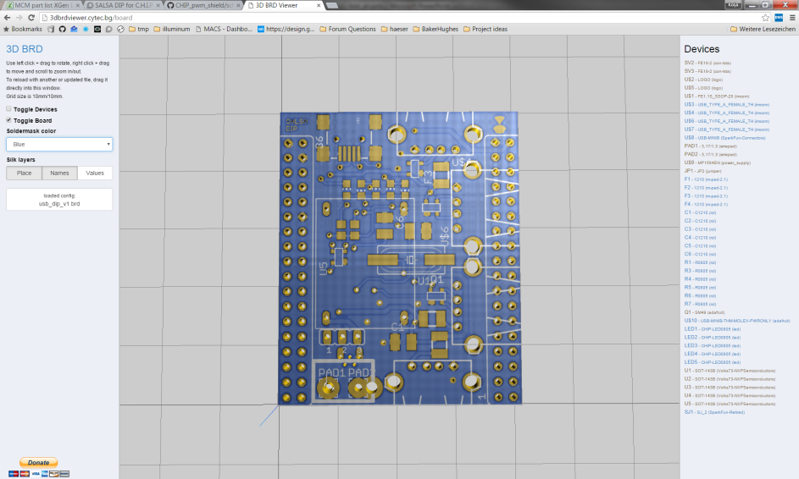
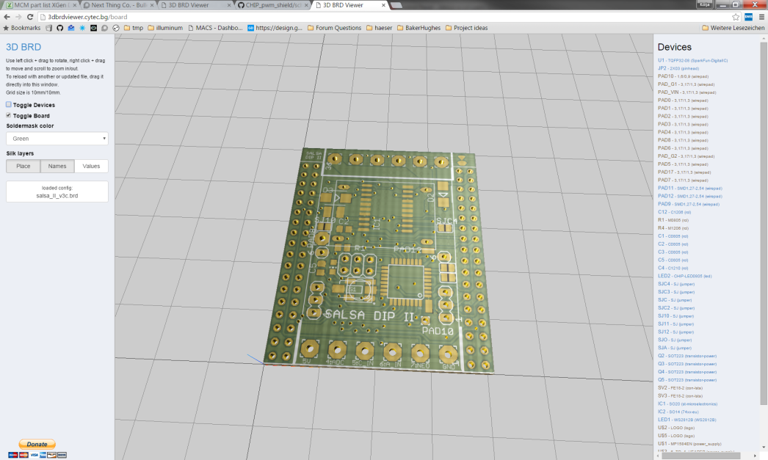
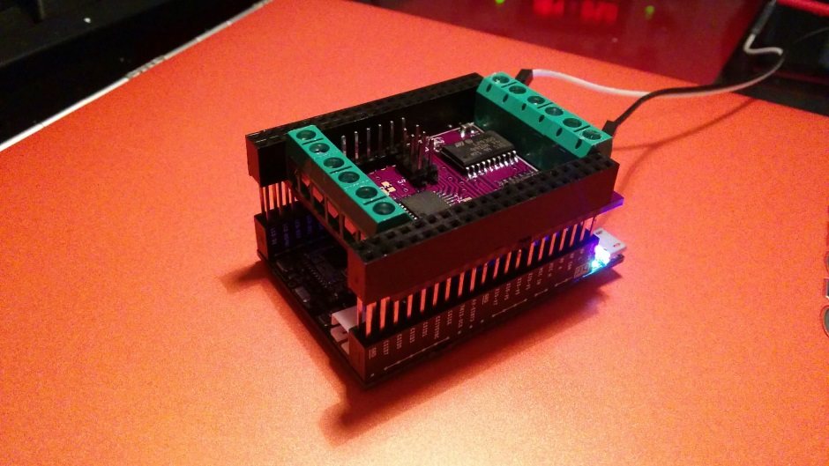
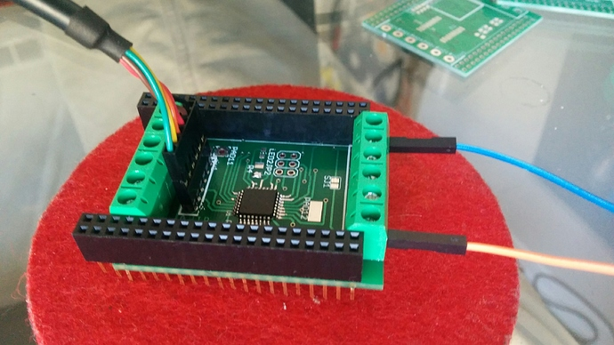
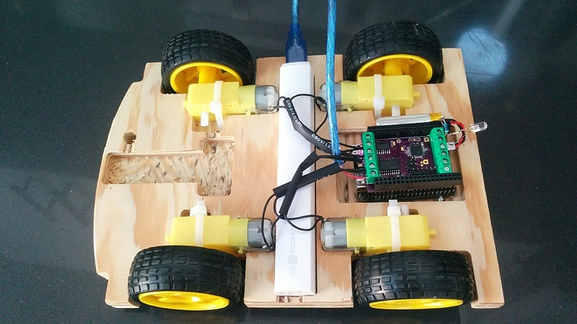
JKW boards – Confusion avoidance chart ☺ LEDv1.1 / Motor v1.1 / preSalsa / Salsa / Salsa II / Queso DIP
Function X = possible - = not possible * = ‘Or’ .. E.g. Motor OR Mosfet / Optional | Motor v1.1 | LEDv1.1 | PreSalsa | Salsa | Salsa II | Queso
Screw terminals that connects an external power supply to CHIP CHR-IN | X | X | X | X | X | X
Controller connected via I2C | - | X | X | X | X | -
Pins for driving ws2812 LEDs | - | X | X | X | X | -
Pins for analog reading | - | X | X | X | X | -
“Real-time” GPIOs | - | X | X | X | X | -
Mosfets to dim a lot of LEDs | - | 4 | 4* | 4* | 4*/2X | -
Motor driver Channels | 2 | - | 2* | 2* | 2*/1X | -
Input for “High voltage” (~7V for the Motor) | X | - | - | - | X | -
Internal connection to CHIP power button pin, e.g. to start the CHIP from power off, or to shut the CHIP down | - | - | - | X | X | -
“Seamless power” (run on CHIP battery, with CHIP powered down) | - | - | - | - | X | -
Option for onboard power supply (DC in 7-28V) | - | - | - | - | X | X
CHIP pins used by board (besides I2C bus which is not exclusively used) | *4 | *1 | *5 | *6 | *6 | -
On board Ws2812 LED option | - | - | - | * | * | -
On board general purpose button (e.g. shutdown for CHIP?) | - | - | - | - | * | -
On board general purpose LED | - | - | X | * | * | -
4x USB Hub | - | - | - | - | - | X
preSalsa, Salsa and Salsa II can all be assembled as Dual-channel (4 outputs) Motor driver OR 4-channel Mosfet - PWM Driver
(Salsa II can be configured as 1 channel motor AND 2 channel Mosfet – PWM)

Slide 4
Salsa II DIP Photos
ORDERED 2016/03/03
Configuration PWM dimmer
Configuration Motor driver

Slide 5
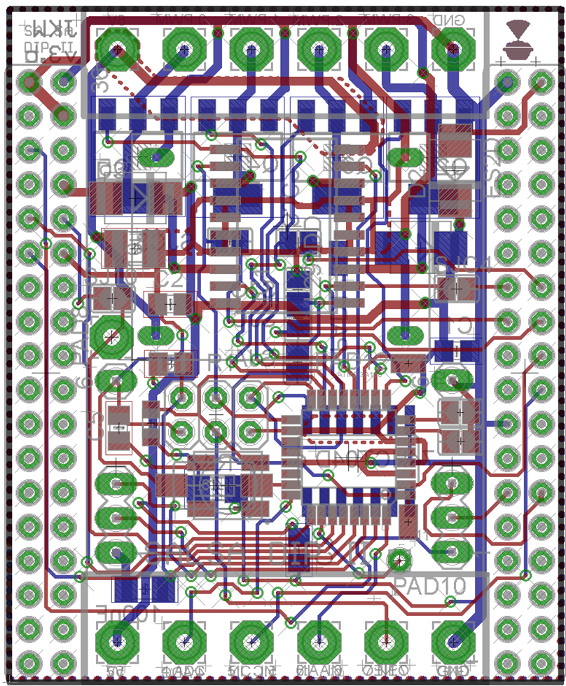
Atmega pin | DIP pin | Arduino Pin | Digital IN/OUT | Analog IN | PWM out | WS2812 support | C.H.I.P. pin | Motor Pins
PC0 | P16 | 14 | X | - | - | - | - | -
PD4 | P15 | 4 | X | - | - | - | - | -
PB5 | P14 | 13 | X | - | - | - | - | DL
PB4 | P13 | 12 | X | - | - | - | - | DR
PD7 | P12 | 7 | X | - | - | X | - | -
PB0 | P11 | 8 | X | - | - | X | - | -
PC3 | P10 | 17 | X | X | - | - | - | -
PD3 | P9 | 3 | X | - | X | X | - | ER
PC2 | P8 | 16 | X | X | - | - | bridge to pwr on | -
PB3 | P7 | 11 | X | - | X | X + On board | - | -
PD2 | P6 | 2 | X | - | - | X | - | -
- | P5 | - | - | - | - | - | X | -
PC1 | P4 | 15 | X | X | - | - | - | -
PD5 | P3 | 5 | */X | - | X | * | - | -
PD6 | P2 | 6 | */X | - | X | * | - | -
PB1 | P1 | 9 | */X | - | X | * | - | -
PB2 | P0 | 10 | */X | - | X | * | - | EL
Low side PWM, 6A, 30V
Or Motor Driver, 600mA
Channel P0,P1,P2,P3
Vin
GND
P11
4x Transistor
+ Inverter on Bottom and Motor driver + power supply on the top layer!
P12
Salsa II DIP PinOut
Accel header connected to
CHIP I2C_2
P8
ICSP header
UART header
GND
-
-
PC TX
PC RX
Reset
P9
P10
GLED or
Ws2812 or button
Vout
GND
P4
P6
* Only without transistor
and a little solder bridge
Direct connected to CHIP GPIO 7
P7

Slide 6
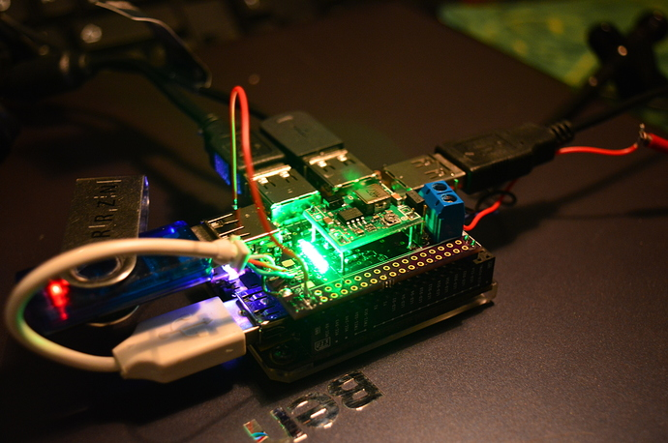
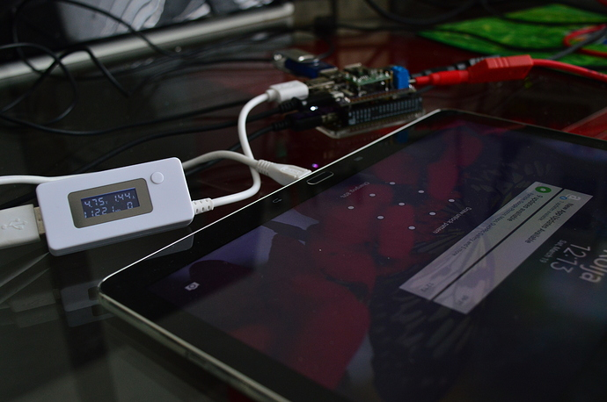
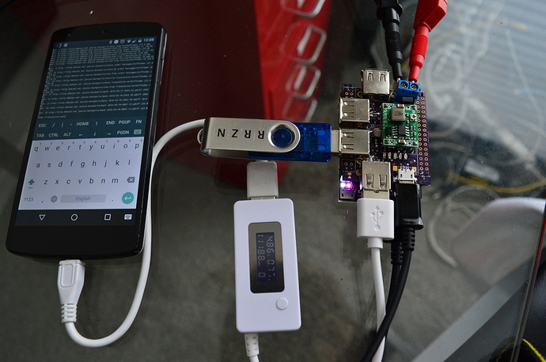
Queso DIP v4.3 Photos
ORDERED 2016/03/01
EXPECTED 2nd Week of April
Test-board-photos

Slide 7
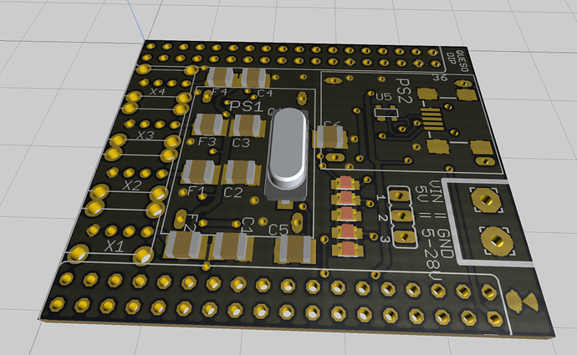
Queso DIP v4.3 PinOut
ORDERED 2016/03/01
Can carry one (recommended) or up to two DCDC regulator
Micro USB
Input jack
4x USB-A to the bottom of the board
Power IN via
Screw-Terminals
7-28V DC in, 5V
3A out
Port activity LEDs

Slide 8
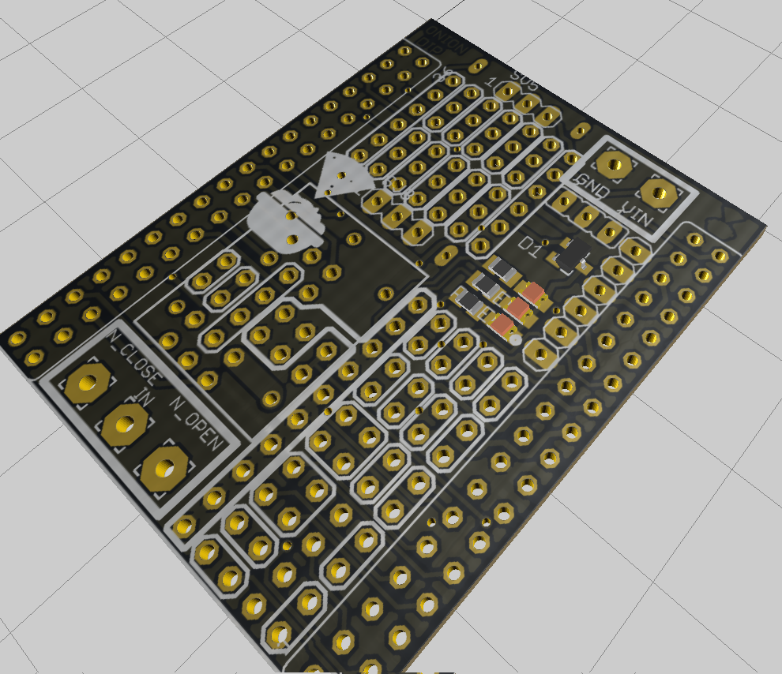
ONION DIP v1.0 Photos
ORDERED 2016/03/16
NOT YET RECEIVED

Slide 9
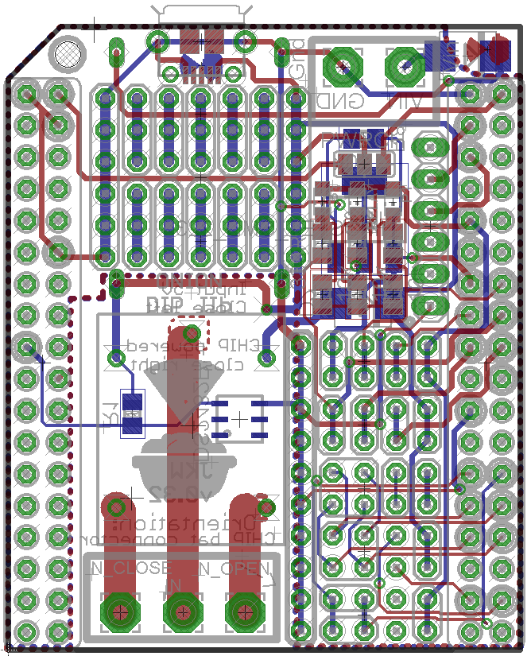

Slide 10
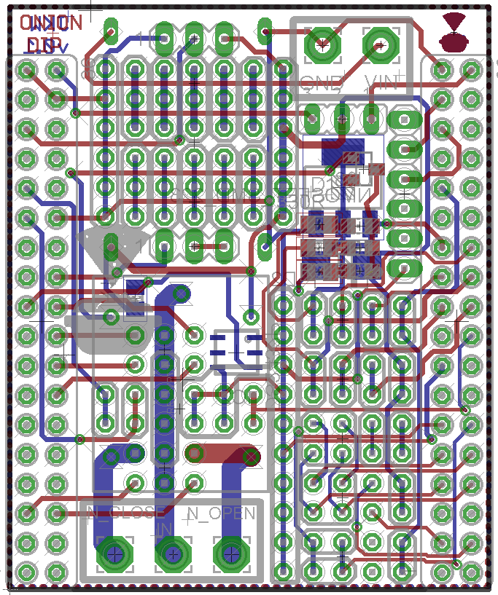
ONION DIP v1.0 PINOUT1/2
ORDERED 2016/03/16
NOT YET RECEIVED
Screw terminal for power in
Battery pins
Standard USB-UART Connector
Stand-alone tinker area for DIL ICs with power rails left & right
Optional: MOSFET on P0 (active high) to drive the relay
Optional: DC-DC regulator to power the CHIP from 7-28V DC, covering tinker area
3x LED, P0 &P3 active low,
On Relay closed
Optional: Relay to switch e.g. 110/230V AC Power lines @ 10A
GPIO P0-P5, each pin twice
2x SPI-2
Screw terminal for Relay contacts:
N_close, In, N_open
2x I2C-2

Slide 11
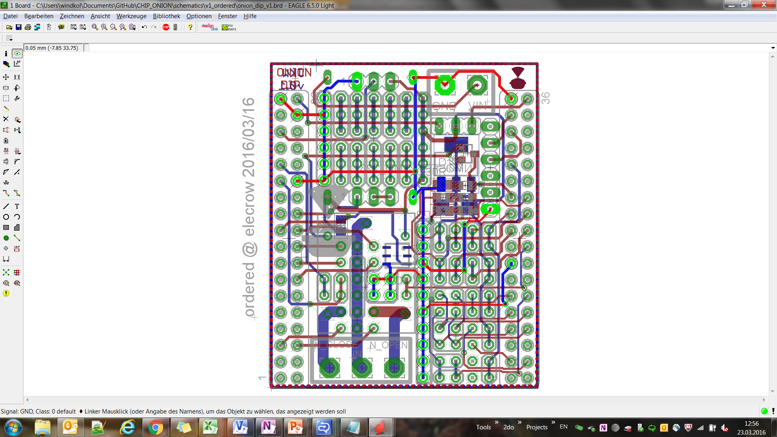
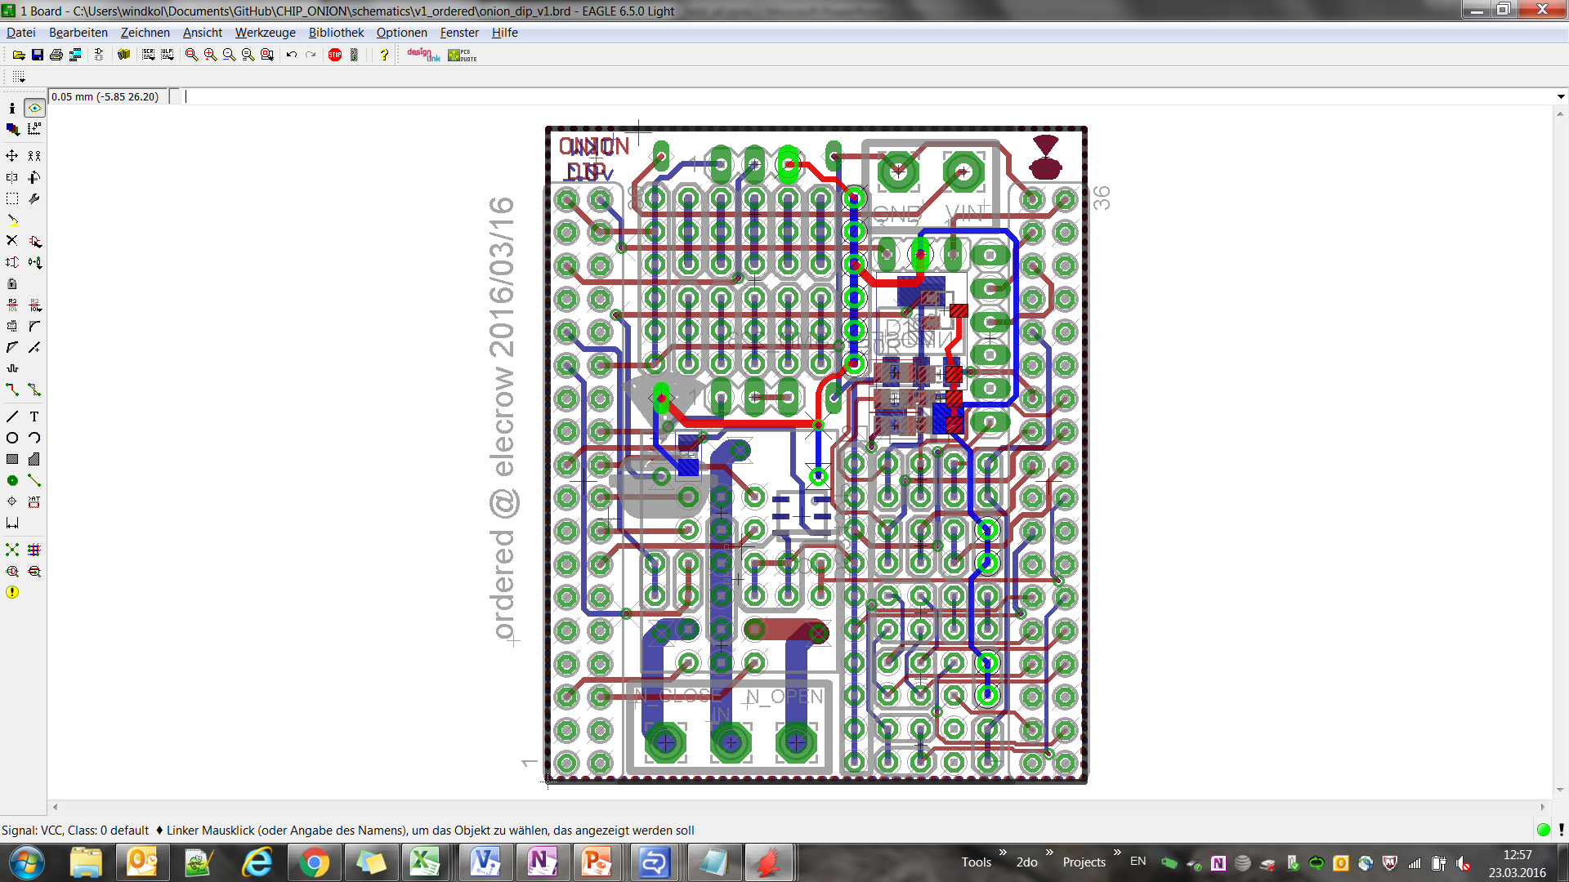
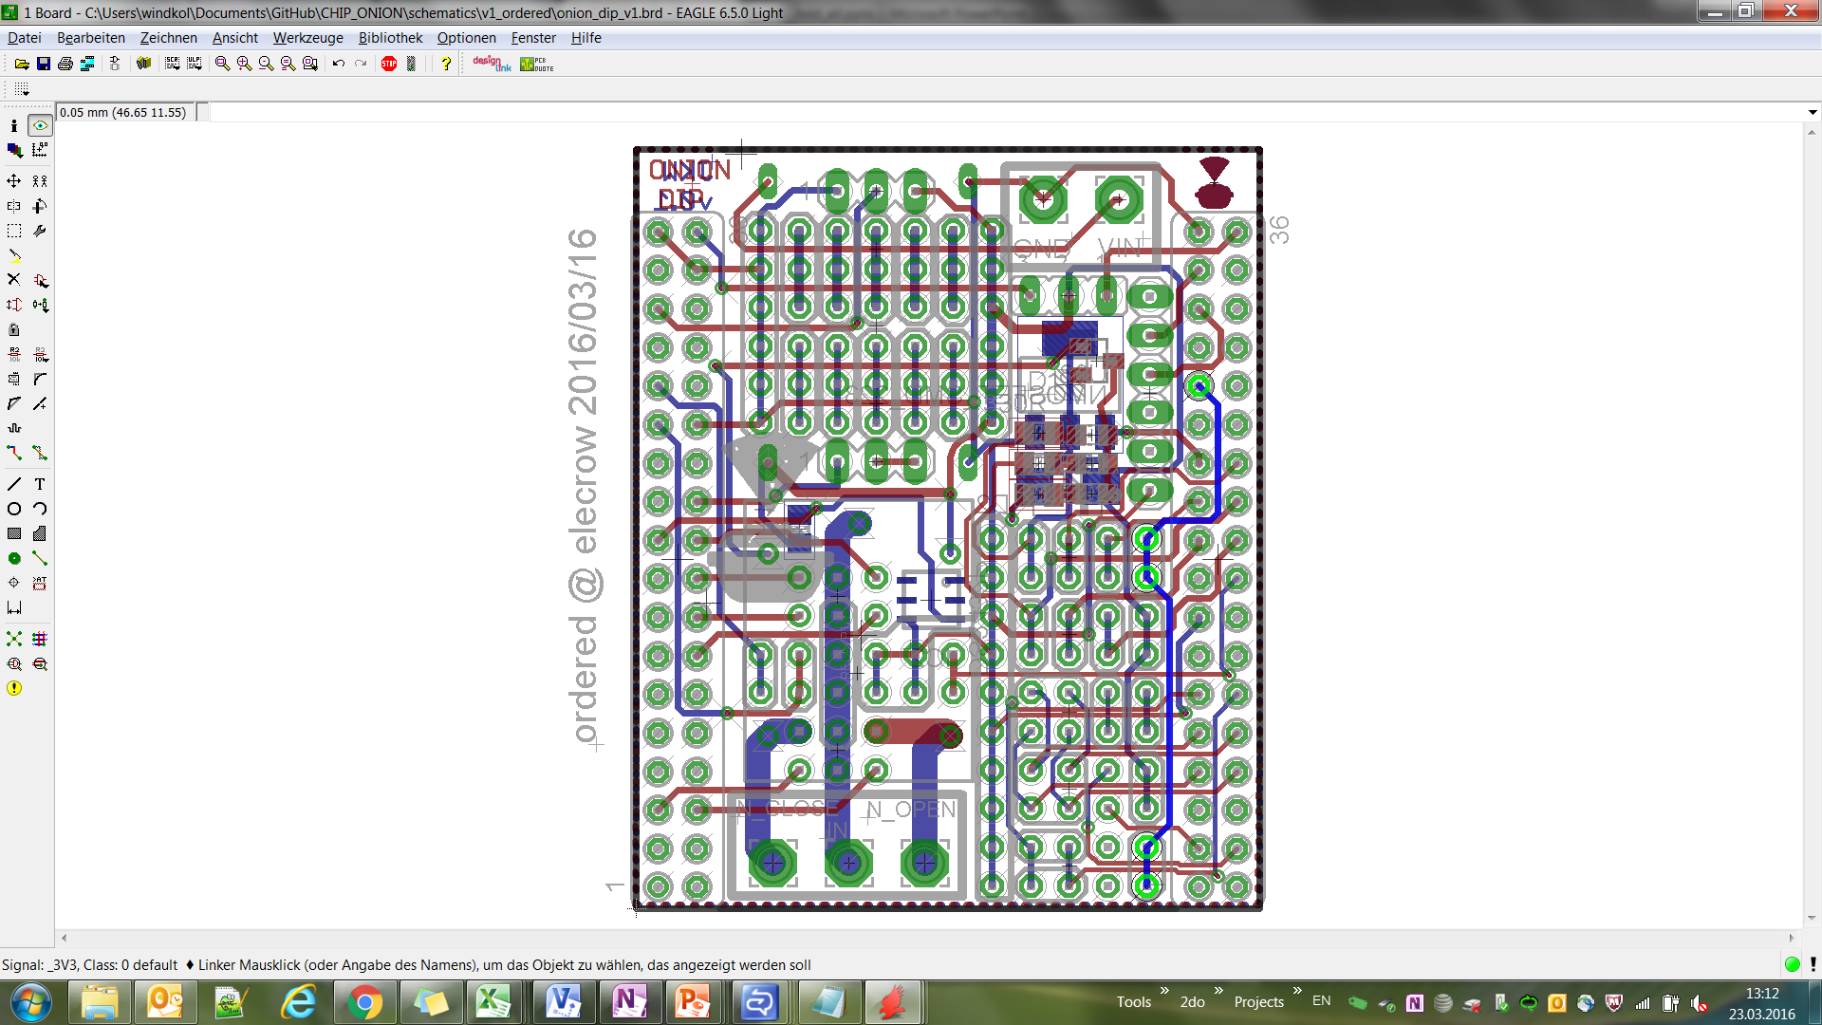
ONION DIP v1.0 PINOUT2/2
ORDERED 2016/03/16
NOT YET RECEIVED
GND Rails highlighted
5V Rails highlighted
CHIP 3.3V Rails

Slide 12
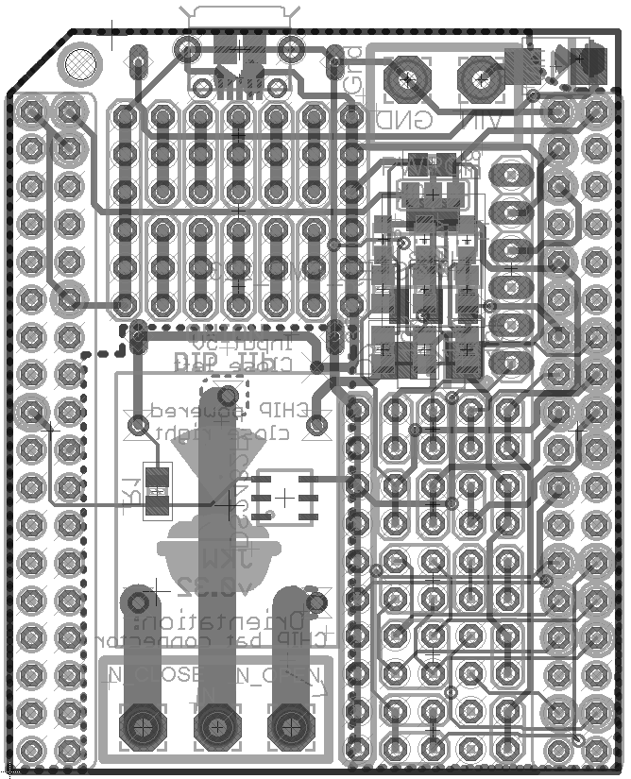
ONION DIP v2.0 PINOUT
P | Desc.
D | SDA2
C | SCL2
I | Vin
O | Vout
C | Charge Voltage
5 | 5V from CHIP
3 | 3.3V from CHIP
G | GND
* | Tinker con
O | SPI MOSI (CSIHSYNC)
I | SPI MISO (CSIVSYNC)
C | SPI CLK (CSICK)
S | SPI CS0 (CSIPCK)
* | D pins
* | P pins
T/R | UART
I
G
G
I
G
C
G
1
2
3
4
5
O
G
5
G
G
1
2
3
4
5
O
T
G
1
2
3
4
5
O
C
O
5
R
G
6
7
8
9
0
O
T
G
6
7
8
9
0
O
R
3
G
G
6
7
8
9
0
O
3
0
1
O
0
1
G
2
3
O
0
G
0
1
2
3
4
5
G
0
1
2
3
G
3
4
5
O
G
G
3
4
5
O
G
S
C
A
B
D
C
G
O
I
A
B
S
C
Install a DCDC converter and supply 7-28V to Vin. This will power the Onion. Connect Vout to Vcharge to power C.H.I.P. as well.
Supply steady 5V to Vin, bridge Vin to Vout to power the Onion and Vout to Vcharge to power C.H.I.P.
Connect 5V to Vout if you have stable 5V on the C.H.I.P. but don’t use a lot of current
G
S
C
3
O
O
I
G
O
I
2
O
G
D
C
3
2
3
G
D
C
3

Slide 13
Old boards
The following pages show old boards, which are not longer produced:
LED DIP v1.1
preSalsa DIP
Salsa I
Motor Dip v1.1

Slide 14
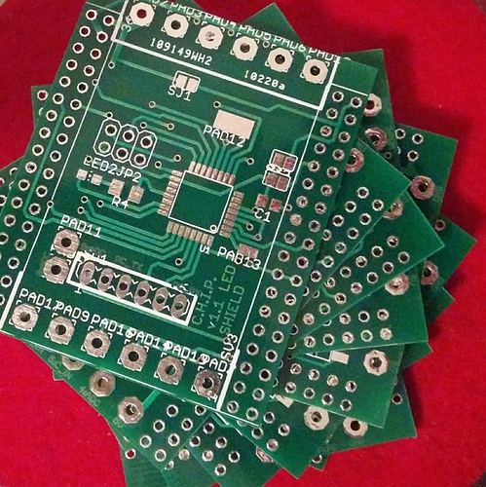
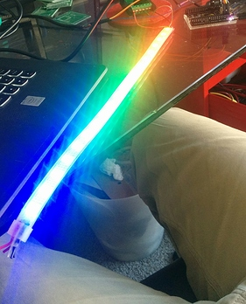
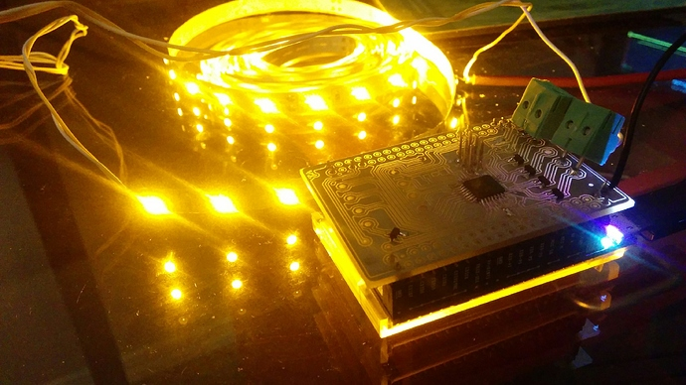
LED DIP v1.1 Photo

Slide 15
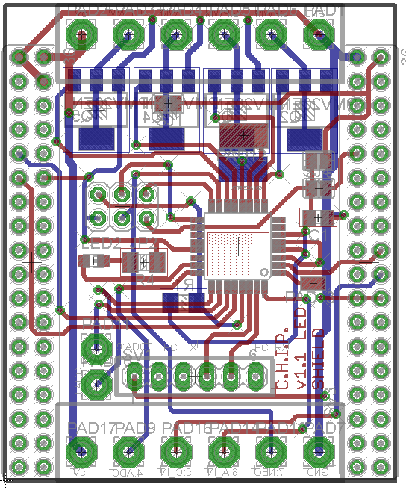
LED DIP v1.1 PinOut
Low side PWM, 6A, 30V
Or Motor Driver, 600mA
Channel P0,P1,P2,P3
Vin
GND
Atmega pin | DIP pin | Arduino Pin | Digital IN/OUT | Analog IN | PWM out | WS2812 support | C.H.I.P. connection
PD7 | P12 | 7 | X | - | - | X | -
PB0 | P11 | 8 | X | - | - | X | -
PC3 | P10 | 17 | X | X | - | - | -
PD3 | P9 | 3 | X | - | X | X | -
PC2 | P8 | 16 | X | X | - | - | -
PB3 | P7 | 11 | X | - | X | X | -
PD2 | P6 | 2 | X | - | - | X | -
- | P5 | - | - | - | - | - | X
PC1 | P4 | 15 | X | X | - | - | -
PD5 | P3 | 5 | */X | - | X | * | -
PD6 | P2 | 6 | */X | - | X | * | -
PB1 | P1 | 9 | */X | - | X | * | -
PB2 | P0 | 10 | */X | - | X | * | -
P12
4x Transistor
on Bottom or Motor driver + Inverter on the top layer!
P11
ICSP header
P9
P10
P8
UART header
GND
-
-
PC TX
PC RX
Reset
Vout
GND
P4
P6
Direct connected to CHIP GPIO 7
P7
* Only without transistor
And a little solder bridge

Slide 16
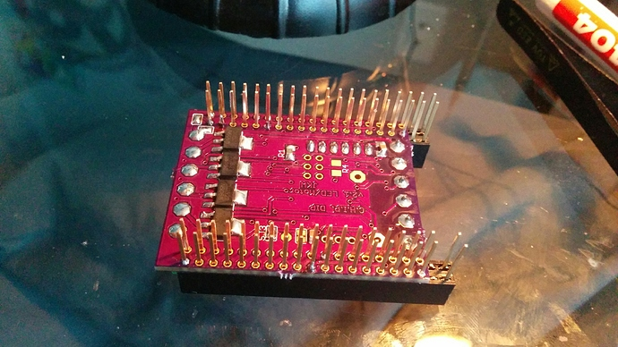
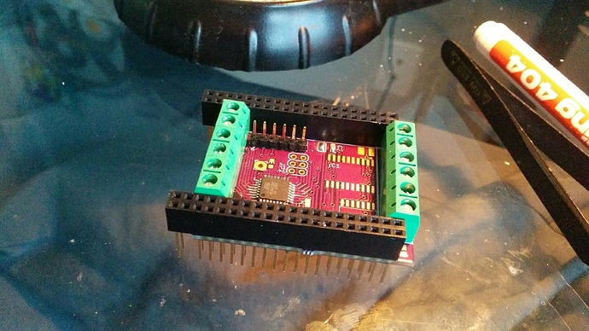
preSalsa DIP Photo
Motor Version ->
LED Driver / Mosfet Version

Slide 17
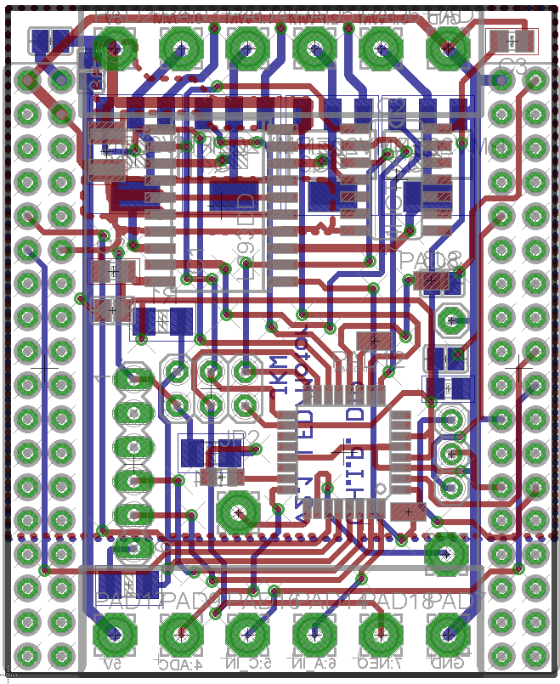
preSalsa DIP PinOut
Low side PWM, 6A, 30V
Or Motor Driver, 600mA
Channel P0,P1,P2,P3
Vin
GND
Atmega pin | DIP pin | Arduino Pin | Digital IN/OUT | Analog IN | PWM out | WS2812 support | C.H.I.P. connection
PD7 | P12 | 7 | X | - | - | X | -
PB0 | P11 | 8 | X | - | - | X | -
PC3 | P10 | 17 | X | X | - | - | -
PD3 | P9 | 3 | X | - | X | X | -
PC2 | P8 | 16 | X | X | - | - | -
PB3 | P7 | 11 | X | - | X | X | -
PD2 | P6 | 2 | X | - | - | X | -
- | P5 | - | - | - | - | - | X
PC1 | P4 | 15 | X | X | - | - | -
PD5 | P3 | 5 | */X | - | X | * | -
PD6 | P2 | 6 | */X | - | X | * | -
PB1 | P1 | 9 | */X | - | X | * | -
PB2 | P0 | 10 | */X | - | X | * | -
P11
P12
4x Transistor
on Bottom or Motor driver + Inverter on the top layer!
Accel header connected to
CHIP I2C_2
ICSP header
P8
UART header
GND
-
-
PC TX
PC RX
Reset
P9
P10
Vout
GND
P4
P6
Direct connected to CHIP GPIO 7
P7
* Only without transistor
And a little solder bridge

Slide 18
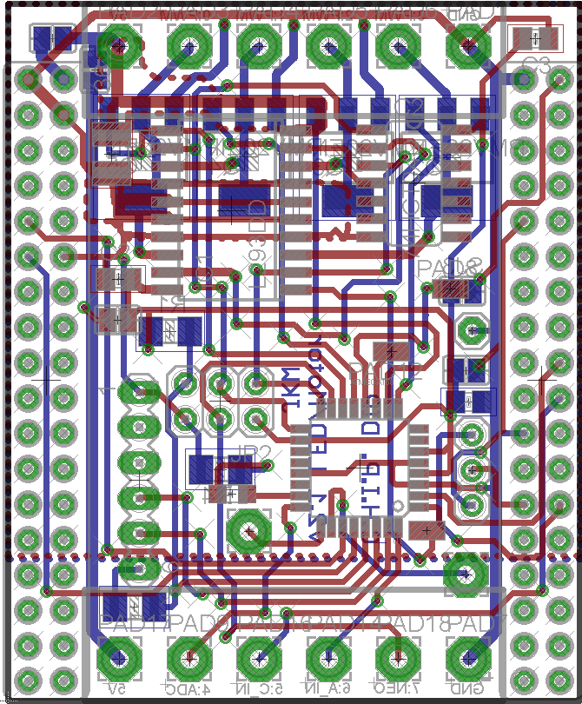
PreSalsa Jumper Config
Vin
Low side PWM, 6A, 30V
Channel T0,T1,T2,T3
GND
SJ | Function
1 | Vin to Charge in If your input voltage is 5V close this jumper. Your Vin will charge your Battery
2 | Vout to Vcc If your Vin is not 5V close it, to get CHIPs 5V on the output If your Vin is 5V and you close SJ5, close this one to power the DIP from the VIN, in this case you must leave SJ3 and SJ4 open!
3 | CHIP 5V to Vcc (bot) If you won’t power the DIP via VIN, close this jumper to supply 5V power via the CHIP If you’ve destroyed your CHIP onboard 5V, close it to supply power to the USB ☺
4 | CHIP 3.3V to Vcc (bot) If you want to work the DIP on the (limited) 3.3V of the CHIP
5 | Vin to Vout To forward your input to the output
SJ1
SJ5
SJ3
SJ2
SJ4
Combine: SJ1 + SJ5 + SJ2 if your Vin is 5V or
SJ2 + SJ3 if you only draw a few mA to use the CHIPs 5V
Vout
GND
Never combine: SJ3 and SJ4 or
SJ4 + SJ2 + SJ5 and supply power via Vin/Vout or
SJ3 + SJ2 + SJ5 and supply power via Vin/Vout or
SJ1 if your Vin is NOT ~5V or SJ2 + SJ5 if your Vin > 5V
PC1
PD2
Direct connected to CHIP GPIO 7
PB3

Slide 19
Salsa DIP Photos
WAITING ON CHINA POST
ORDERED 2016/02/10
Configuration PWM dimmer
Configuration Motor driver

Slide 20
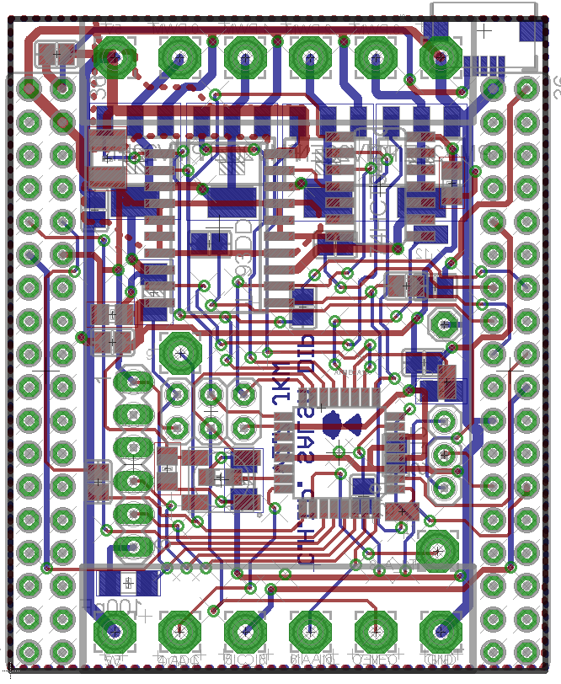
Salsa DIP PinOut
Atmega pin | DIP pin | Arduino Pin | Digital IN/OUT | Analog IN | PWM out | WS2812 support | C.H.I.P. pin | Motor Pins
PC0 | P16 | 14 | X | - | - | - | - | -
PD4 | P15 | 4 | X | - | - | - | - | -
PB5 | P14 | 13 | X | - | - | - | - | DL
PB4 | P13 | 12 | X | - | - | - | - | DR
PD7 | P12 | 7 | X | - | - | X | - | -
PB0 | P11 | 8 | X | - | - | X | - | -
PC3 | P10 | 17 | X | X | - | - | - | -
PD3 | P9 | 3 | X | - | X | X | - | ER
PC2 | P8 | 16 | X | X | - | - | - | -
PB3 | P7 | 11 | X | - | X | X | - | -
PD2 | P6 | 2 | X | - | - | X | - | -
- | P5 | - | - | - | - | - | X | -
PC1 | P4 | 15 | X | X | - | - | - | -
PD5 | P3 | 5 | */X | - | X | * | - | X
PD6 | P2 | 6 | */X | - | X | * | - | -
PB1 | P1 | 9 | */X | - | X | * | - | -
PB2 | P0 | 10 | */X | - | X | * | - | EL
Low side PWM, 6A, 30V
Or Motor Driver, 600mA
Channel P0,P1,P2,P3
Vin
GND
Micro USB
P11
4x Transistor
on Bottom or Motor driver + Inverter on the top layer!
P12
Accel header connected to
CHIP I2C_2
P8
ICSP header
UART header
GND
-
-
PC TX
PC RX
Reset
P9
P10
Ws2812 or LED
Vout
GND
P4
P6
Direct connected to CHIP GPIO 7
P7
* Only without transistor
And a little solder bridge

Slide 21
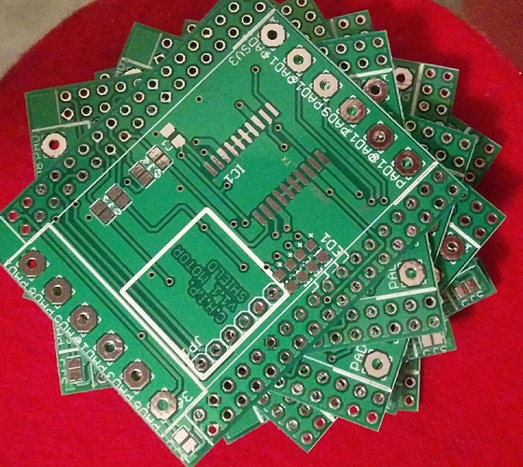
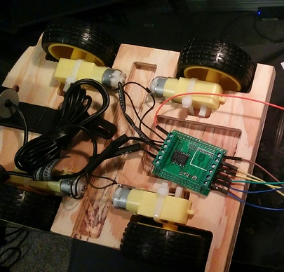
Motor DIP v1.1 Photos

Slide 22
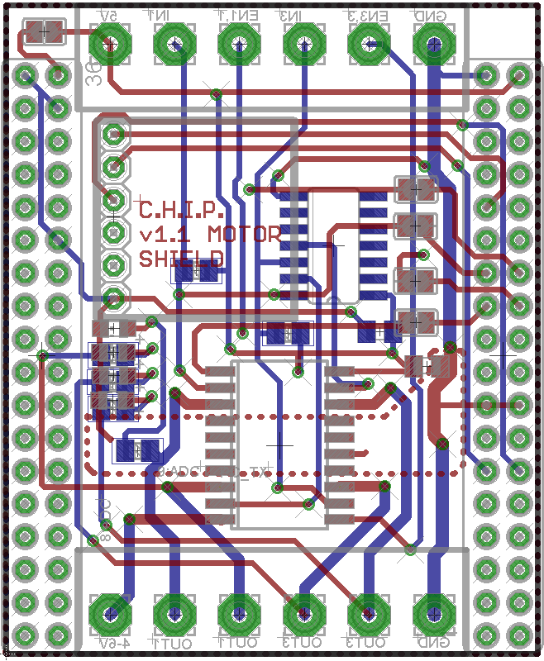
Motor DIP v1.1 Pin Out
P3
P1
Vin
P0
P2
GND
# | Function
Vin | Logic voltage, 5V
P0 | Channel 1 direction
P1 | Channel 1 enable
P2 | Channel 3 direction
P3 | Channel 3 enable
GND | Ground for logic voltage
VHin | “High” voltage for Motor (5-36 Volt), can be connected to Vin
P4 | Channel 1 output
P5 | Channel 2 output (inverse of channel 1)
P6 | Channel 3 output
P7 | Channel 4 output (inverse of channel 3)
GND | Ground for “high” voltage
Inverter
Accel
Header for
Sparkfun:
MMA8452Q Connected to CHIP I2C bus
P9
CHIP GPIO P0, P1, P2, P3 can be used instead of screw header
Status LED
Motor
Driver IC
L293DD
VHin
GND
P4
P6
P5
P7

Slide 23
P3
Motor DIP v1.1 Jumper Config
P1
Vin
P0
P2
GND
SJ5
SJ | Function
1-4 | Use CHIP GPIO as input Close them, if you use the CHIP GPIO to generate the control signals. Leave them open if you want to use the screw header
5 | Vin to Charge in Close it if you Vin is 5V from a power supply or external battery to power this CHIP over this pin as well Leave it open, if you feed the CHIP 5V to the Vin
SJ1-4
Accel
Header for
Sparkfun:
MMA8452Q Connected to CHIP I2C bus
P9
CHIP GPIO P0, P1, P2, P3 can be used instead of screw header
Status LED
(resistors on bot,
LED and resistor aren’t populated)
Motor
Driver IC
L293DD
VHin
GND
P4
P6
P5
P7

Slide 24
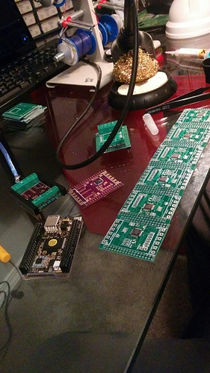
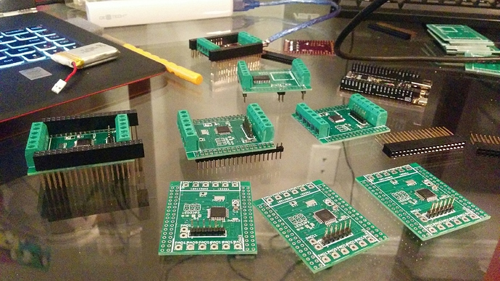
More photos

